Slide 1
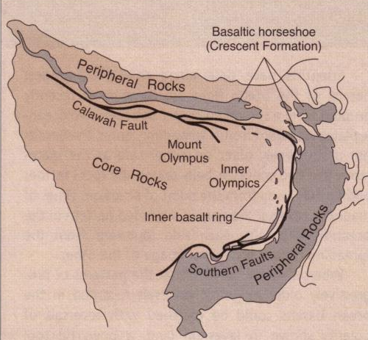
Notes:
The exposed basaltic rocks form a horseshoe-shaped region, from whence the name Crescent Formation is derived. Now it just so happens that the trademark of Olympia Beer is …

Slide 2
Geo-advertising?
Notes:
… that’s right, a horseshoe! Is this just a coincidence or were the brewers of Olympia taking advantage of the local geology and engaging in what might be considered geo-advertising?

Slide 3
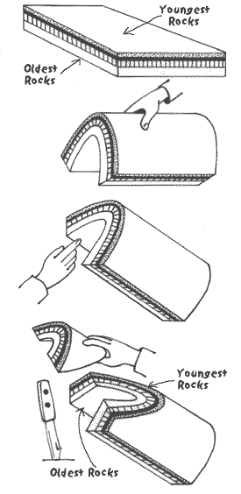
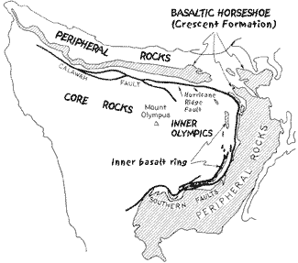
The Plunging Anticline Hypothesis
Notes:
Either way the basaltic horseshoe dominates the geologic structure of Olympic National Park. The initial hypothesis for the origin of the horseshoe proposed that it represented an eroded plunging anticline. Since older rocks are folded into the core of anticlines, if this hypothesis was correct, then progressively older rocks would be found towards the center of the basaltic horseshoe.

Slide 4
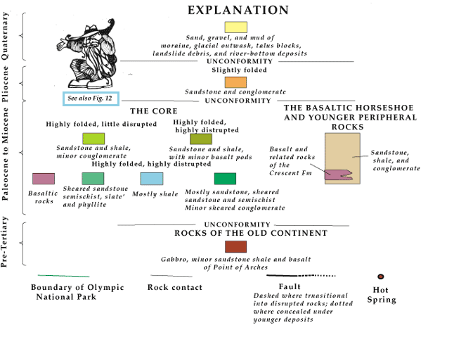
Key to the Geologic Map
Notes:
However, when techniques for dating these rocks were developed,

Slide 5
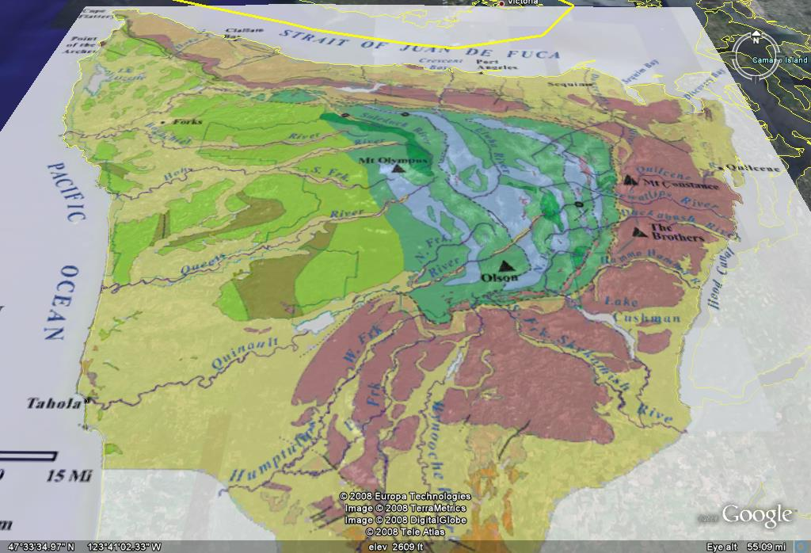
Notes:
… a much different pattern of ages emerged.

Slide 6
GENERALLY YOUNGER ROCKS
Notes:
The rocks generally became younger towards the core of the horseshoe.

Slide 7
same age
Notes:
I say generally, because there is a lot of repetition of rock ages here. Repeated rock ages are not a pattern that is typically produced by folding. It can, however, happen by reverse faulting. With these age relations in mind …

Slide 8
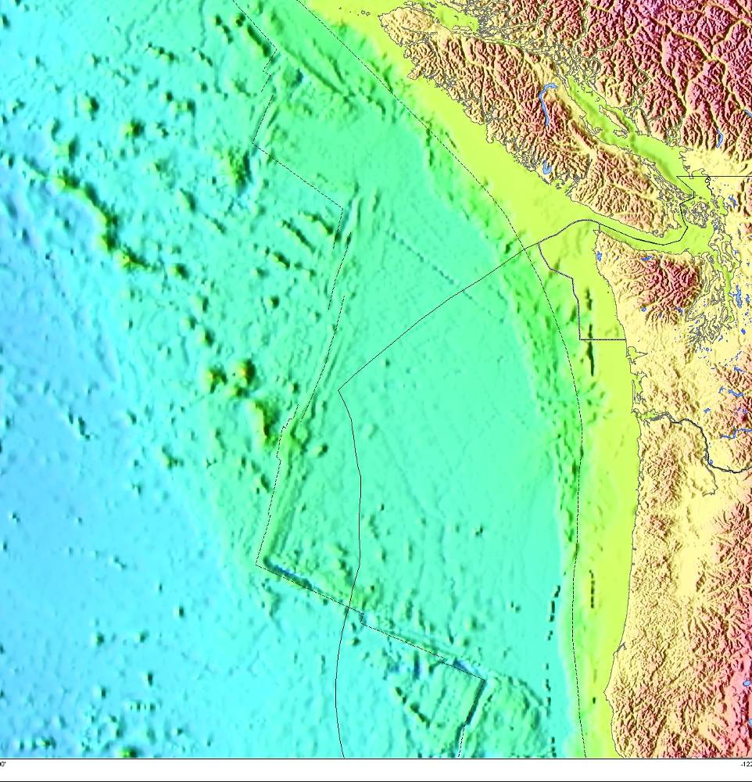
Olympic National Park
Cascadian
Subduction
Juan de Fuca Ridge
Zone
Notes:
… and noting the proximity of the park to the Juan de Fuca Ridge and the Cascadian Subduction Zone, it became apparent that the rocks in Olympic National Park represent an accretionary wedge.

Slide 9
Thrusting
Thrust age
Younger
Older
Notes:
A snowplow analogy works well to understand accretionary wedges and why younger rocks occur towards the western part of Olympic National Park somewhat under the older rocks. Notice how deeper, older rocks get pushed up by the snow plow up and over the younger rocks.

Slide 10
North American Plate
Thrusting
ACCRETIONARY WEDGE
Juan de Fuca Plate
Thrust age
Younger
Older
Notes:
The geologic equivalent of the snowplow is the North American Plate. The sediments are getting scraped off the Juan de Fuca Plate and the pile is the accretionary wedge.

Slide 11
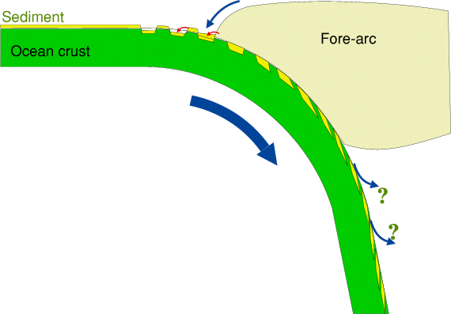
Primitive Island Arcs: no sediment accretion
Notes:
The amount of sediment that is added to the wedge depends on several factors. First, if subduction has only recently been initiated, then the subducted ocean crust is usually very old, cold and dense, so the angle of subduction tends to be very steep. In these situations the subducted plate bends markedly causing tensional stresses on the outside of the bend which produce a series of basins that hold and subduct virtually all the sediment brought to the trench from the forearc region. Thus, no accretionary wedge forms, but very deep trenches do.

Slide 12
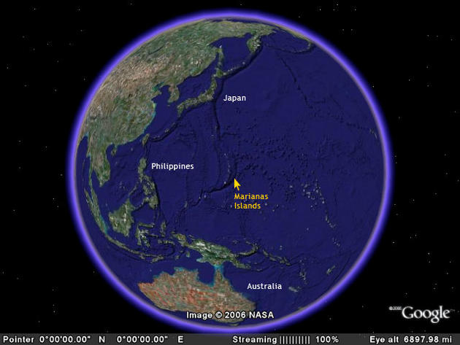
Notes:
Good examples are the relatively young Marianas Islands which border the deepest trench in the world.

Slide 13
Northern Chile: little sediment to subduct
Notes:
A second factor that affects accretionary wedge formation is the amount of sediment delivered to the trench. In the Atacama Desert of Northern Chile, annual rain fall averages 2 inches per year, so despite the relatively low subduction angle, there is so little sediment shed from the land that virtually all of it is subducted and no accretionary wedge develops.

Slide 14
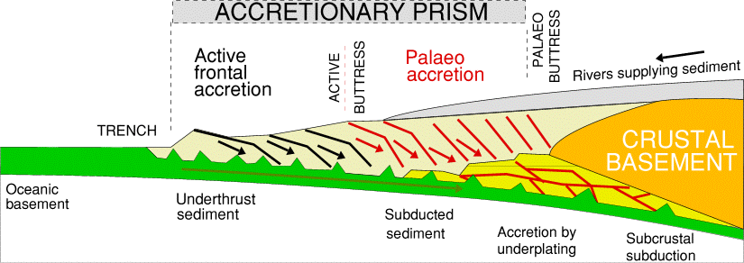
S. Chile and Alaska: high sediment input
Notes:
On the other hand where rivers supply a lot of sediment, like in Southern Chile, Alaska, (and no doubt Washington state as well), a large accretionary wedge will develop.

Slide 15
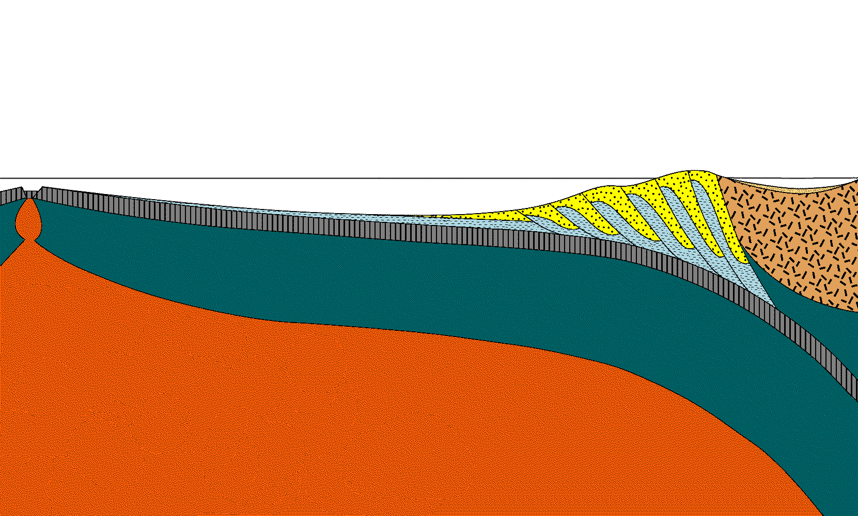
Olympic National Park
Juan de Fuca Ridge
Puget Sound
accretionary wedge
Notes:
The accretionary wedge in Olympic National Park should be similar to the model presented here, although I need to make a disclaimer: This is how I understand it. To the best of my knowledge this is the way it is, but I could be wrong!

Slide 16
Oceanic crust
Lithospheric mantle
Continental crust
Asthenosphere
Notes:
First let’s label the layers.

Slide 17
North American Plate
Juan de Fuca Plate
Notes:
The oceanic plate is the Juan de Fuca and the continental plate is the North American. Like the oceanic Juan de Fuca Plate, the base of the North American Plate is made of lithospheric mantle, …

Slide 18
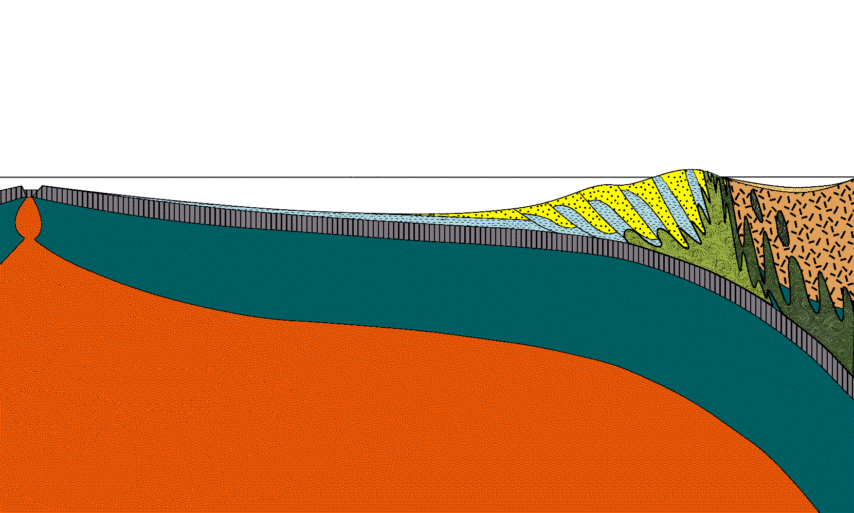
North American Plate
Juan de Fuca Plate
serpentinite
Notes:
…. but here most of it has been altered into a greenish rock called serpentinite. More on serpentinite later. On top of the Juan de Fuca Plate two kinds of sea floor sediment deposit.

Slide 19
pelagic clay
clay
(ooze)
clay
Notes:
The first is pelagic clay, which deposits at very slow rates from clay particles carried in suspension by ocean currents and blown out to sea on the wind. Pelagic clay usually contains some component of plankton shells, which if greater than 30%, qualifies the sediment as ooze. However, there is very little ooze on the Juan de Fuca Plate because the Juan de Fuca Ridge is a mere 350 km offshore, so the clay component (which comes from the nearby land) is usually greater than 70%. Even though the percentage of clay is relatively high, the total amount of sediment on the Juan de Fuca Plate is relatively low, because the plate is just too young to allow for a large amount of sediment to accumulate. Therefore pelagic clay will not be the main component of the accretionary wedge.

Slide 20
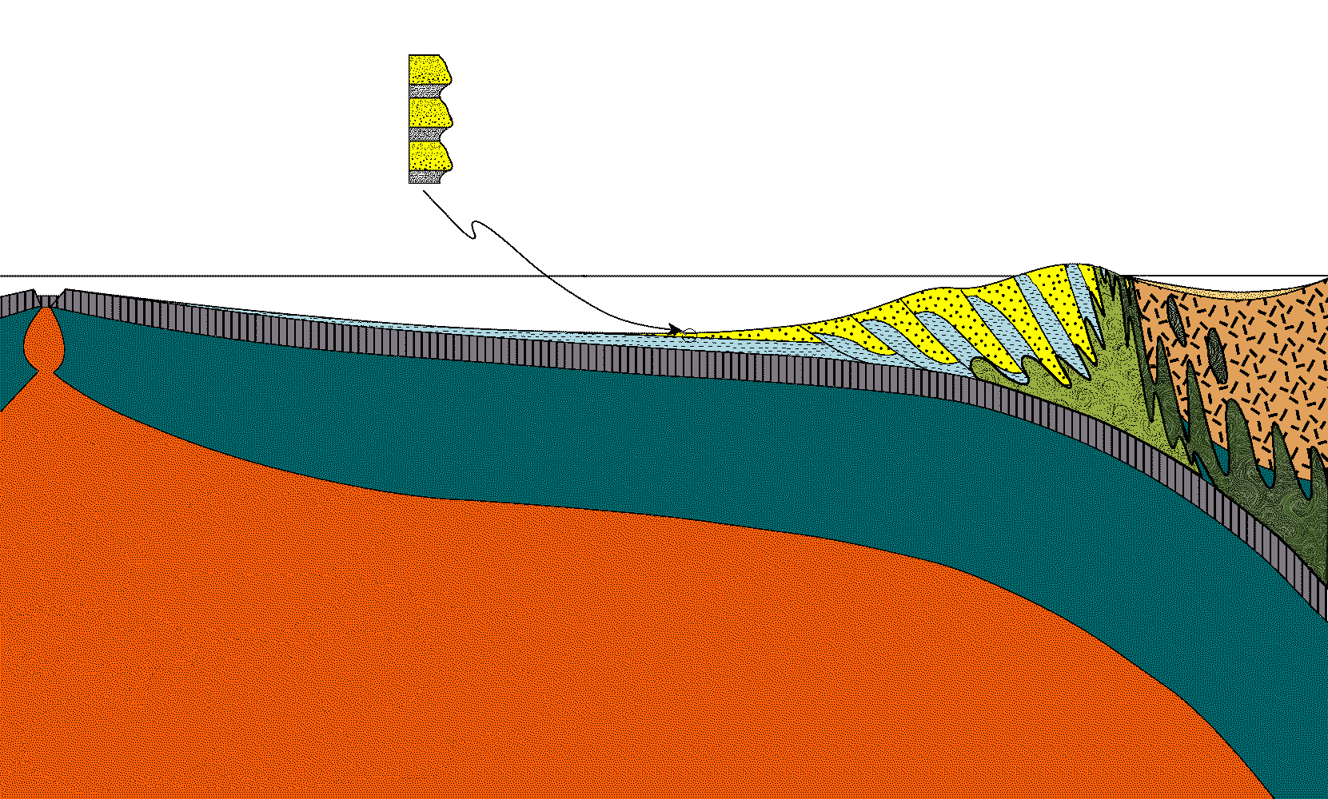
turbidite
Notes:
On the other hand, the extreme rainfall amounts over Olympic National Park contribute to turbidite being the main component of the wedge.

Slide 21
turbidite
turbidity current
Notes:
Although the deposition of pelagic clay is slow and continuous, turbidite deposits rapidly but sporadically via turbidity currents that may occur centuries apart.

Slide 22
Turbidite
Sandstone (1 day)
1 meter / 1000 years
Shale (300 yrs.)
Shale (300 yrs.)
Sandstone (1 day)
Shale (300 yrs.)
Sandstone (1 day)
turbidity current
Notes:
Thus, distinctly layered sequences of sediment form consisting of sandstone from the turbidity currents and shale (or mudstone) from the deposition of pelagic clay. A single, layer of shale may take 300 years to form, whereas an equivalent thickness of sandstone takes less than a day to deposit. The overall rate of sedimentation here is about 1 meter per 1000 years, which is extremely high.

Slide 23
turbidite
turbidity current
Notes:
The huge amount of turbidite deposited explains in part why there is no trench here.

Slide 24
turbidite
turbidity current
~3 cm/yr
Notes:
Additionally, the rate of spreading at the Juan de Fuca Ridge is pretty slow, only about 3 cm/year, so subduction has little chance of keeping up with the rate of sedimentation.

Slide 25
turbidity current
Notes:
So the trench is completely filled with sediment and turbidity currents roll way out to sea…

Slide 26
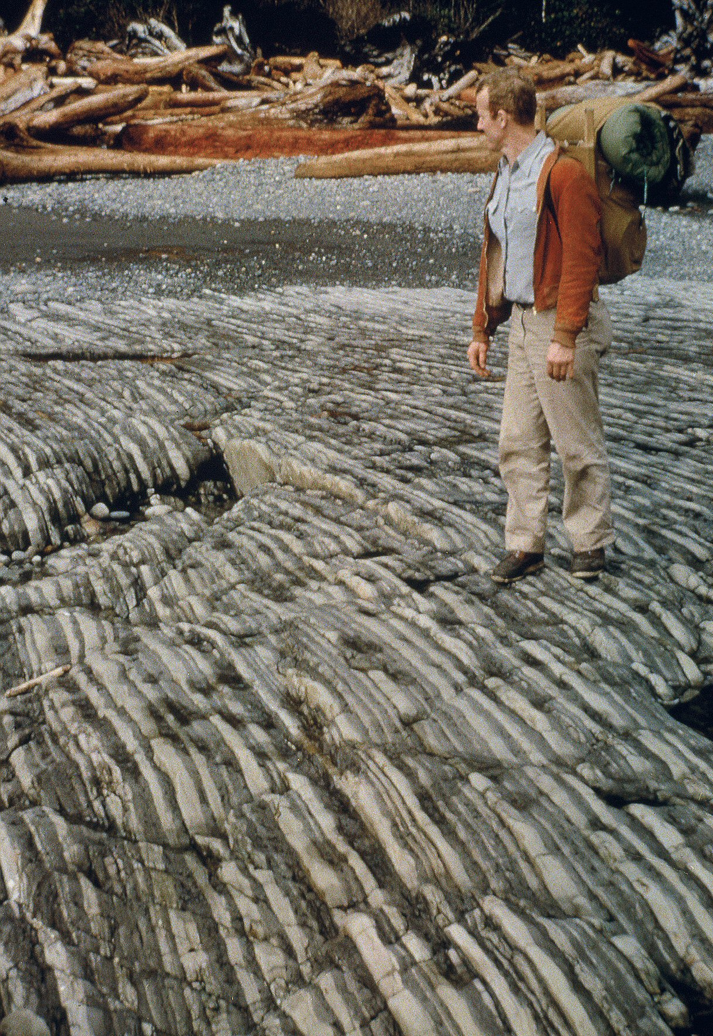
Notes:
…which explains the thinness and exceptional lateral continuity of the turbidites in the park. But why are these strata nearly vertical and …

Slide 27
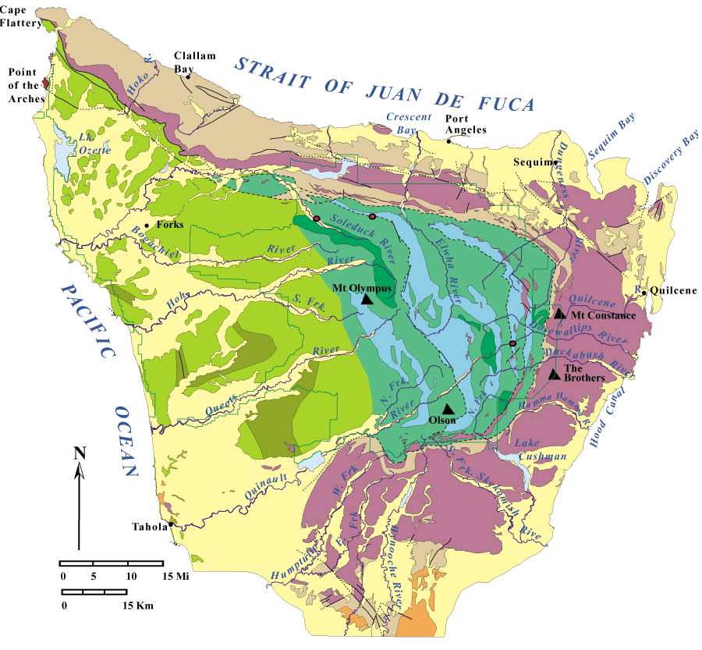
YOUNGER
same age
Notes:
… why is there repetition in rock ages yet the rocks get generally younger to the west?

